Slide 1
Chapter 1: Introduction to
Software Engineering Design
Session II: Overview of Software Engineering Design

Slide 2
Session’s Agenda
Software Engineering Design
  Why study software engineering design?
Software design challenges
  Requirements volatility
  Processes
  Technology
  Ethical and Professional issues
  Managing design influences
Software design process
  Software architecture
  Detailed design
  Construction design
  HCI design

Slide 3
Software Engineering Design
In the previous session, we presented a general motivation for software engineering design and important concepts for designers. These included:
  Design for large-scale, complex, systems
  The software engineering life-cycle
  A micro-process for problem solving, and
  A holistic (macro) process for problem solving
In the previous session, design was introduced as a systematic and intelligent process for generating, evaluating, and specifying designs for devices, systems, or processes.
In software engineering, design provides blueprints that capture how software systems will meet their required functions and how they will be shaped to meet their intended quality.

Slide 4
Software Engineering Design
Formally, software engineering design is defined as:
  (1) The process of identifying, evaluating, validating, and specifying the architectural, detailed, and construction models required to build software that meets its intended functional and non-functional requirements; and,
  (2) the result of such process.
In the software industry, the term design is used interchangeably to describe both the process and product resulting from such process.
  From the process perspective, it describes the phase, activities, tasks, and interrelationship between them required to model software’s structure and behavior before construction.
    This is concerned mostly with the project management’s aspect of development.
  From the product perspective, it describes artifacts resulting from design activities, e.g., class diagram.
    This is concerned mostly with the technical aspects of development.

Slide 5

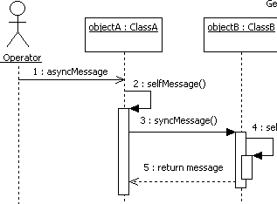
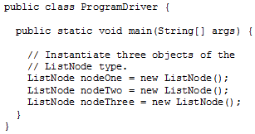

Software Engineering Design – Product Development
From the product development’s perspective, studying software design is important, mainly, because:
  Requirements are mapped to conceptual models of software
  Provide models that represent structure and behavior
  Main components and interfaces are identified
  Quality of future system is born
    Modularization, cohesiveness, coupling, etc.
    Provide means to evaluate quality attributes, e.g., usability.
  Solutions can be reused in other projects
  Design forms the foundation for all other development activities
    Construction
    Testing
    Maintenance

Slide 6






Software Engineering Design –Project Management
From the project management’s perspective, studying software design is important, mainly, because:
  Good software design help minimize effects of requirements’ volatility
    This can minimize impact on schedule and cost.
  Increases efficiency in human resource allocation.
    Designs decompose systems so that teams can work on different parts of the problem in parallel.
    By decomposing system, teams can work in distributed fashion.
    These can have positive effects in schedule and cost.
  Shields the project from having “one guy” owning the whole system.
    Multiple personnel owns multiple components.
      If one leaves the company, it is easier to replace…
    Documented designs can be used by new personnel to minimize the learning curve.
Overall, design helps improve project management.
  Planning, organization, staffing, and tracking

Slide 7
Software Design Challenges
Today, the software design phase has evolved from an ad-hoc and sometimes overlooked phase to an essential phase of the development life-cycle.
The increasing complexity of today’s software systems has created a set of particular challenges that makes it hard for software engineers to meet the continuous customer demand for higher software quality.
These challenges have prompted software engineers to pay closer attention to the design process:
  To better understand, apply, and promulgate well-known design principles, processes, and professional practices.
The major design challenges include:
  Requirements volatility
  Inconsistent development processes
  Fast, and ever-changing technology
  Ethical and professional practices
  Managing design influences
To understand these better, we need to explore them in more depth…

Slide 8

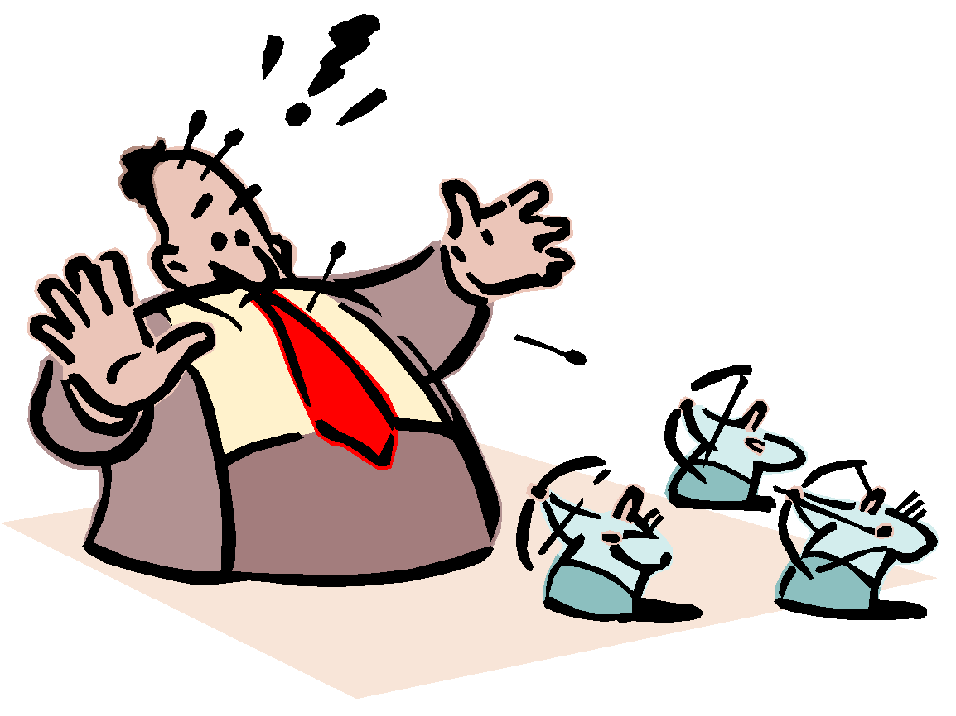

Software Design Challenge #1 –
Requirements Volatility
Requirements’ volatility is a major reason for the complexity of software projects.
  The common view is that software can be modified “easily”
    Requirements are not fully specified before design and construction
    Requirements are changed after design and construction
  Consider if we take this approach for the development of a house!
Desired Product
Oops… I don’t remember seeing a requirement for this…
Product Developed
Product Developed
Customers now want a bigger house and more windows by next week!
There goes my job again!!

Slide 9
Software Design Challenge #1 –
Requirements Volatility
In software projects, although much effort is put into the requirements phase to ensure that requirements are complete and consistent, that is rarely the case.
  This makes the software design phase the most influential one when it comes to minimizing the effects of new or changing requirements.
  This forces designers to create designs that provide solutions to problems at a given state while also anticipating changes and accommodating them with minimal effort.
Because of requirements’ volatility, software engineers must have a strong understanding of the principles of software design and develop skills to manage complexity and change in software projects.

Slide 10
Software Design Challenge #2 –
The Process
Software engineering is a process-oriented field. In the design phase, processes involve a set of activities and tasks required to bridge the gap between requirements and construction. For example:
  Architectural and detailed designs
  Design reviews
  Establishing quality evaluation criteria
  Establishing design change management and version control
  Adopting design tools
  …
The problem is that in many cases, a company’s design process
  is not well established,
  is poorly understood,
  is approached with minimalistic expectations,
  is focused on one form of design, e.g., user interface, while ignoring others, or,
  is simply, not done at all!

Slide 11
Software Design Challenge #3 –
The Technology
The technology for designing and implementing today’ software systems continues to evolve to provide improved capabilities. For example,
  Modeling languages and tools
  Programming languages
  Integrated development environments
  Design strategies, patterns, etc.
  …
As new technologies emerge, software designers are required to assimilate and employ them all at the same time.
  In some cases, old and new technology needs to coexist in the same project!
This creates a demand for capable designers that can assimilate new concepts and technology quickly and effectively.
  This is challenging because of the time required for both learning new technology and completing a project on-time, while making sure that the new technology interoperates well with old legacy systems.

Slide 12
Software Design Challenge #4 –
Ethical and Professional Practices
Designers create blueprints that drive the construction of software.
  Tight schedules can create external pressures to deviate from the formal design process to get the product out the door.
  In some cases, this can have catastrophic consequences
To correctly and responsibly execute the design phase, designers are required to exert strong leadership skills to:
  Influence and negotiate with stakeholders
  Motivate the development team
  Enforcing ethical guidelines
  Evaluate the social impacts of their designs in the public domain or in safety-critical systems
  Follow and enforce the ethical and professional practices
This is a challenge when attempting under numerous pressures from different stakeholders, e.g., management, customer, peers, etc.

Slide 13
Software Design Challenge #5 –
Managing Design Influences
Besides negative pressures, designs are shaped by other influences from stakeholders, the development organization, and other factors (e.g., the designers’ own experiences).
These influences can have cyclical effects between the system and its external influences, such that external factors affect the development of the system and the system affects its external factors [1].
Managing these influences is essential for maximizing the quality of systems and their related influence on future business opportunities.
Of specific importance are design influences that come from
  the system’s stakeholders and,
  its developing organization

Slide 14


Software Design Challenge #5 –
Managing Design Influences
Software projects can have a multitude of stakeholders, each with specific wants and needs that influence the software design.
  Some conflicting with each other!
  Each stakeholder believes he/she is correct.
This requires some design trade-offs to satisfy each customer.
  Difficult to do in large-scale systems!
This is difficult to do since design decisions need to accommodate all concerns without negatively affecting the project.
I want performance!
I want Usability!
I want Security!
Yikes!

Slide 15
Software Design Challenge #5 –
Managing Design Influences
The developing organization also influences designs significantly.
  Consider software development across site boundaries!
    Consider coordinating design efforts
    Consider conducting peer reviews
    Consider developing code from design
    Consider managing version control
  In this case, design must support such development!
At the same time, designs can influence the developing organization to enter new areas of business.
  Consider a design that supports plug-ins to enhance capabilities of the software. Someone may realize that existing functionality can be enhanced via plug-in to solve a problem in a different domain, giving the developing organization a competitive advantage!
Managing these influences is challenging because it requires designers to span out of the technical domain to have keen interest in the organization as a whole.

Slide 16
Software Design Process
Up until now, we have spent quite a bit of time discussing properties of software design. We have also defined software design from the process perspective, which referred to the phase, activities, tasks, and interrelationship between them required to model software’s structure and behavior before construction.
  However, we have not formally described what goes on within the design phase.
  Let‘s examine in depth the software design process…
A software design process is a set of activities and controls that specify how resources work together for the production of software design artifacts.
  Two major activities of the software design process include:
    Software Architecture
    Detailed Design

Slide 17
Software Design Process
Software Architecture
  Corresponds to a macro design approach for creating models that depict the quality and function of the software system.
  Provides black-box models used to evaluate the system’s projected capabilities as well as its expected quality.
  Designed using multiple perspectives, therefore, allows different stakeholders with different backgrounds to evaluate the design to ensure that it addresses their concerns.
  It provides the major structural components and interfaces of the system.
  It focuses on the quality aspects of the system before detailed design or construction can begin.
  They serve as important communication, reasoning, and analysis tool that supports the development and growth of the system [1]
  Lays the foundation for all subsequent work in the software engineering life-cycle.

Slide 18
Software Design Process
Detailed Design
  Whereas software architecture deals with the major structural components and interfaces of the system, detailed design focuses mostly on the internals of those components and interfaces.
  Begins after the software architecture activity is specified, reviewed, and deemed sufficiently complete.
  Builds on the software architecture to provide a white-box approach to design the structure and behavior of the system.
  Refines the architecture to reach a point where the software design, including architecture and detailed design, is deemed sufficiently complete for the construction phase to begin.
  Focuses on functional requirements, whereas the architecture focuses mostly on non-functional, or quality, requirements.
  Two important tasks of the detailed design activity include:
    Interface Design
    Component Design

Slide 19
Software Design Process
Interface design
  Refers to the design activity that deals with specification of interfaces between components in the design.
  Provide a standardized way for accessing services provided by software components.
  Allow for multiple efforts to occur in parallel, as long as interfaces are obeyed, therefore, it is one of the first tasks during detailed design.
  Can be performed for both internal interfaces and external interfaces, e.g., XML messaging specification for communication across the network.
Component design
  During architecture, major components are identified. During component design, the internal design of (the structure and behavior of) these components is created.
  In object-oriented systems, using UML, component designs are typically in the form of class diagrams, sequence diagrams, etc.
  When creating these designs, several design principles, heuristics, and patterns are often used in professional practice.
  Sometimes referred to as component-level design.

Slide 20
Software Design Process
Software architecture and detailed design are well-known activities of the software design phase, however, other important activities are required for supporting the creation of architectural and detailed designs.
  Therefore, when scoping the software design process, the effort required for these other activities must be considered!
Other important activities that require time and effort include:
  Design documentation
  Management activities
An often neglected activity when scoping design efforts is the design that occurs during construction. This form of design is important to model complex functions or routines identified during detailed design.
  Construction design is a form of detailed design that occurs mostly during the construction phase.
  Construction design is important to reason, communicate, and document the solution to complex programming problems.
Another important design activity is the Human-computer interface design.
  Design activity where general principles are applied to optimize the interface between humans and computers.

Slide 21
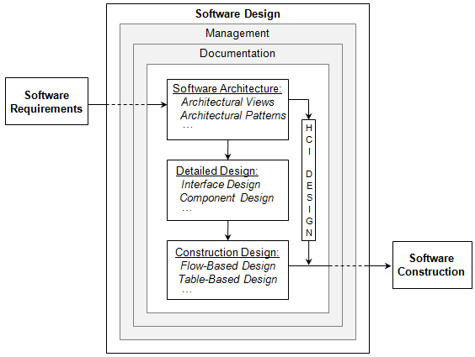
Software Design Process
The software design phase has several activities, each having one or more tasks.
  Architecture
    Identifying views
    Identifying patterns
    …
  Detailed Design
    Interface design
    Component design
    …
  Construction Design
    Flow-based design
    Table-based design
    …
  Human-computer Interface Design
    …
Each design activity needs to be
  Documented, and
  All processes need to be managed!
We will spend the rest of the semester learning how to carry out these activities (including tasks), how to document these efforts, and how to manage them!

Slide 22
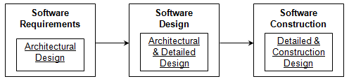
Software Design Process
In the previous slide, it is seen that architectural designs are elaborated through detailed design, which are further elaborated through construction design. In practice, design activities are not carried out in such orderly and controlled fashion.
  Quite a bit of iteration occurs between these activities.
  In a perfect world, all design work would take place during the design phase. In practice, the distribution of design activities varies throughout the software development life-cycle.
  In most projects, most of the design efforts occur during the design phase, but some design inevitably occurs in other life-cycle phases, e.g.,
    Requirements
    Construction
  In some cases, architectural design efforts occur during the requirement’s phase.
  In some cases, detailed design occurs during the construction phase.
  These cases will become evident as we cover these activities during the course.

Slide 23
What’s next…
In the next session, we will continue the focused discussions on software engineering design. Specifically,
  Roles of software designers
    Systems Engineer
    Software architect
    Component designer
    User interface designer
  Design principles
    Modularization
    Abstraction
    Encapsulation
    Cohesion and coupling
    Separation of interface and implementation
    Sufficiency and completeness
  Design strategies
    Object-oriented vs. structured design
  Practical design considerations

Slide 24
References
[1] Bass, Len, Paul Clements, and Rick Kazman. Software Architecture in Practice, 2d ed. Boston: Addison-Wesley, 2003.

